Slide 1

THE COLLEGE PROJECT
One Hour
One student. Five colleges. What will she really pay?
Notes:
No preamble and no agenda. Hand out the packet and go straight to the gut check. The shape of the hour: wow first, words later. Students commit to guesses, see the real numbers, and only then learn the vocabulary. In a PD session, run it exactly this way with the teachers as the learners.

Slide 2
PART 1 · GUT CHECK
Agree or disagree?
1
Colleges with about the same sticker price cost a family about the same.
2
A family earning $80,000 a year makes too much to get much financial aid.
3
The cheapest college is the best deal.
Circle your gut on page 1. You will come back to these at the end.
THE FINANCE LAB · THE COLLEGE PROJECT
Notes:
Solo and silent, under a minute. No discussion yet. These three statements are exactly what Ana's numbers will test, and students revisit them in the close.

Slide 3

PART 2 · MEET ANA
Meet Ana.
Family income: about $80,000 a year.
She got into all five: UCLA, USC, Cal State Long Beach, Pepperdine, Pasadena City College.
Check any school you would cross off as too expensive. Then guess what her family actually pays per year at each.
Notes:
Say: 'A guess you wrote down is worth more than one you kept in your head.' Every student commits a number for every school before the reveal. Blank guess columns are the one thing to nudge.

Slide 4
PART 2 · GUESS FIRST
Five stickers. Write your guesses.
UCLA
$44,200 sticker
?
USC
$99,100 sticker
?
Cal State Long Beach
$28,800 sticker
?
Pepperdine
$95,200 sticker
?
Pasadena City College
$12,800 sticker
?
Gold = what Ana pays after grants and scholarships Light = sticker price (family about $80k, $75k–$110k Scorecard band)
Notes:
Leave this up while students check boxes and write guesses. Sticker price is each school's published cost of attendance: tuition, housing, food, books, transportation.

Slide 5
PART 3 · THE REVEAL
The reveal.
UCLA
$44,200 sticker
?
USC
$99,100 sticker
?
Cal State Long Beach
$28,800 sticker
?
Pepperdine
$95,200 sticker
?
Pasadena City College
$12,800 sticker
$9,136
Gold = what Ana pays after grants and scholarships Light = sticker price (family about $80k, $75k–$110k Scorecard band)
Notes:
First reveal. Students write the real number in the last column on page 1.

Slide 6
PART 3 · THE REVEAL
The reveal.
UCLA
$44,200 sticker
?
USC
$99,100 sticker
?
Cal State Long Beach
$28,800 sticker
$12,630
Pepperdine
$95,200 sticker
?
Pasadena City College
$12,800 sticker
$9,136
Gold = what Ana pays after grants and scholarships Light = sticker price (family about $80k, $75k–$110k Scorecard band)
Notes:
Cal Grant covers systemwide tuition for many California families at the Cal States.

Slide 7
PART 3 · THE REVEAL
The reveal.
UCLA
$44,200 sticker
$14,142
USC
$99,100 sticker
?
Cal State Long Beach
$28,800 sticker
$12,630
Pepperdine
$95,200 sticker
?
Pasadena City College
$12,800 sticker
$9,136
Gold = what Ana pays after grants and scholarships Light = sticker price (family about $80k, $75k–$110k Scorecard band)
Notes:
Let the room react. UCLA lands within about $5,000 of Pasadena City. The Blue and Gold Opportunity Plan covers UC systemwide tuition and fees for California families under $100,000 who qualify for aid; what remains is housing, food, books, transportation.

Slide 8
PART 3 · THE REVEAL
The reveal.
UCLA
$44,200 sticker
$14,142
USC
$99,100 sticker
?
Cal State Long Beach
$28,800 sticker
$12,630
Pepperdine
$95,200 sticker
$61,851
Pasadena City College
$12,800 sticker
$9,136
Gold = what Ana pays after grants and scholarships Light = sticker price (family about $80k, $75k–$110k Scorecard band)
Notes:
Pepperdine barely moves. Do not explain yet. Next slide sets up USC.

Slide 9
Before the last reveal, hands up:
Who crossed off USC?
Notes:
Count the hands out loud. Then advance.

Slide 10
PART 3 · THE REVEAL
USC: $99,100 sticker. $24,976 for Ana.
UCLA
$44,200 sticker
$14,142
USC
$99,100 sticker
$24,976
Cal State Long Beach
$28,800 sticker
$12,630
Pepperdine
$95,200 sticker
$61,851
Pasadena City College
$12,800 sticker
$9,136
Gold = what Ana pays after grants and scholarships Light = sticker price (family about $80k, $75k–$110k Scorecard band)
Notes:
About $74,000 a year in grants and scholarships at Ana's income. Many students guessed far higher, and many crossed USC off. Give the room a moment.

Slide 11
Two private schools. Stickers $3,900 apart.
$36,875 apart for Ana.
Talk with a partner: what could explain it?
Notes:
Partners answer the two Part 3 questions on page 1. Let a few theories stand before offering facts (endowment, merit aid, 'rich school'). The fact to have ready: USC's need-based grants reach families at Ana's income; Pepperdine's give far less. Only each school's own numbers show this, which is why the Net Price Calculator matters.

Slide 12
NAME IT
Same sticker. Different price.
Sticker price
The published cost for one year. Where every student's bill starts.
Net price
What a family actually pays for a year after grants and scholarships: money that does not have to be repaid.
Notes:
Only now does the vocabulary arrive, after students have felt the gap. Read the Name it box on page 1 together.

Slide 13
PART 4 · EXPLORE
Is the cheapest school the best deal?
School | Graduation rate | Median debt | Monthly payment | Median earnings, 10 yrs
UCLA | 93% | $14,000 | $148 | $82,511
USC | 93% | $18,000 | $191 | $92,498
Cal State Long Beach | 82% | $14,289 | $151 | $64,403
Pepperdine | 84% | $23,510 | $249 | $82,939
Pasadena City College | 33% | $6,651 | $71 | $43,937
With a partner: page 2, questions 1–4. Then make your call: where should Ana go?
Notes:
Pairs work page 2. Circulate and ask 'Is that good? Compared to what?' Resist confirming answers. Graduation rate: finished there within 8 years. Median debt and monthly payment: typical graduate who borrowed, standard 10-year plan. Earnings mostly reflect what students studied. Source: College Scorecard.

Slide 14
DISCUSS · FOUR CORNERS
Where should Ana go?
UCLA
USC
Stand by your pick.
Make your case in under a minute:
two numbers, and one thing the numbers can’t tell you.
Persuaded? Move.
Pepperdine
Cal State Long Beach
Pasadena City
THE FINANCE LAB · THE COLLEGE PROJECT
Notes:
Label the four corners, Pepperdine in the center. No room to move? Take a hand count on the board. Honor fit reasons (close to family, size, a program): the numbers are part of the decision, not all of it. Crown no winner.

Slide 15
CLOSE THE DISCUSSION
Two decisions, not one.
WHETHER to keep learning
Your goals and the doors you want open.
WHICH school
Where research like today’s pays off, alongside fit.
There is no single right answer for Ana. It is a decision now, not a guess.
Notes:
The frame arrives here, as the synthesis, not the opener. No path is being sold: every corner of the room had a real case.

Slide 16
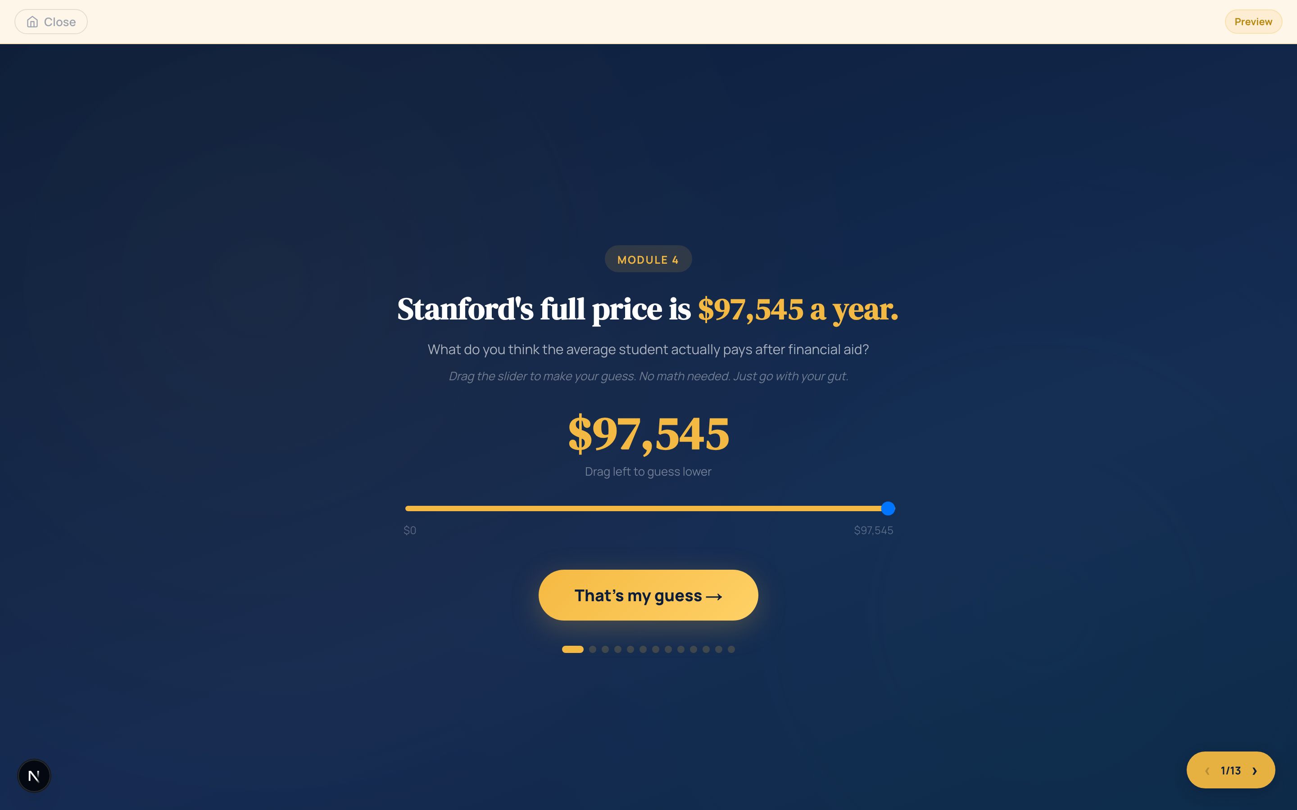
PART 5 · YOUR TURN
Run Ana’s play
for your own student.
Build a student. Pick three schools. Write your guess first.
Then look them up on the School Data Sheet, or at collegescorecard.ed.gov on a laptop.
Which guess landed furthest off?
Notes:
Hand out the School Data Sheet now (not earlier: it shows Ana's prices). Laptops are optional; the sheet covers 28 California schools at all five income bands. Ask a few students to share their biggest miss.

Slide 17
Flip back to page 1.
Would you change any answer?
Which one, and what changed your mind?
Notes:
Share two or three answers aloud. Changed answers on statements 1 and 2 are the lesson landing.

Slide 18
Tonight’s move
Run one Net Price Calculator.
Search “[school name] net price calculator” and do it with a parent or guardian. Don’t cross a school off until you have seen that number.
Notes:
It turns today's income-band average into the family's own estimate. Point to the community college transfer box and Go deeper on page 4.

Slide 19
GO DEEPER
One hour is the on-ramp.
THE WORKBOOK
A quarter or a semester
THE UNIT
9 Launchpad modules
1 HOUR
This lesson
launchpad.thefinancelab.co · thefinancelab.co/college-project
Notes:
Three formats, one project. The Launchpad unit is free and web-based; the workbook (5th edition) runs a quarter or a semester with its Teacher's Guide.

Slide 20

WHY THIS MATTERS
376 to 1
the national student-to-counselor ratio.
Recommended: 250 to 1.
Many students never get real guidance on this decision. That gap is ours to help close.
Notes:
For PD sessions; skip with students. ASCA, 2023-24. Many students will never get hours of one-on-one guidance on this decision. One class period is a real start; a unit is better.

Slide 21
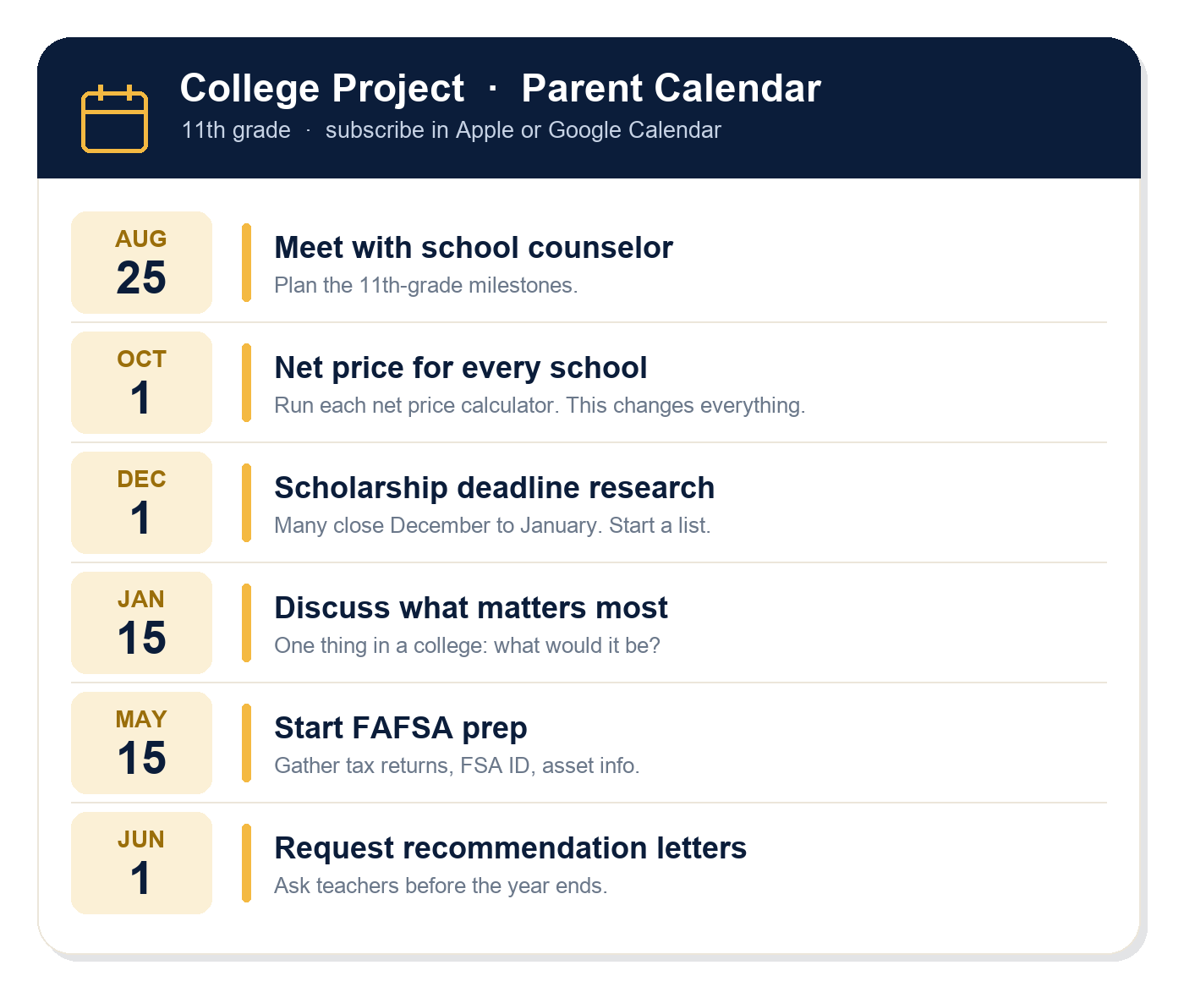
THE FULL UNIT IS BUILT FOR YOU
Turnkey, not a binder of homework.
✓ Standards alignment guide (AB 2927)
✓ Capstone project + rubric
✓ Parent guide + subscribable deadline calendars
✓ A personalized student timeline
✓ Full teacher facilitation guide
Notes:
For PD sessions; skip with students. The full unit ships with standards mapping, a capstone and rubric, a parent guide plus .ics calendars families can subscribe to, a student-built deadline timeline, and a facilitation guide.

Slide 22

thefinancelab.co
The College Project · Free through The Finance Lab
Notes:
Close. Point to thefinancelab.co/college-project for every format.

